Slide 1
Data scientist, 1e jaar
Thesis
Data aggregation and visualisation
Grietus Mulder

Slide 2
Introduction
Objective
Get insight in measurement data
Emphasis in finding patterns during the day over a year
Methods to include:
Data import (CSV and SQL)
Data cleaning
Data aggregation
Data visualisation
Preferably: adaptable looks
Average electricity consumption in Flanders for every weekday

Slide 3

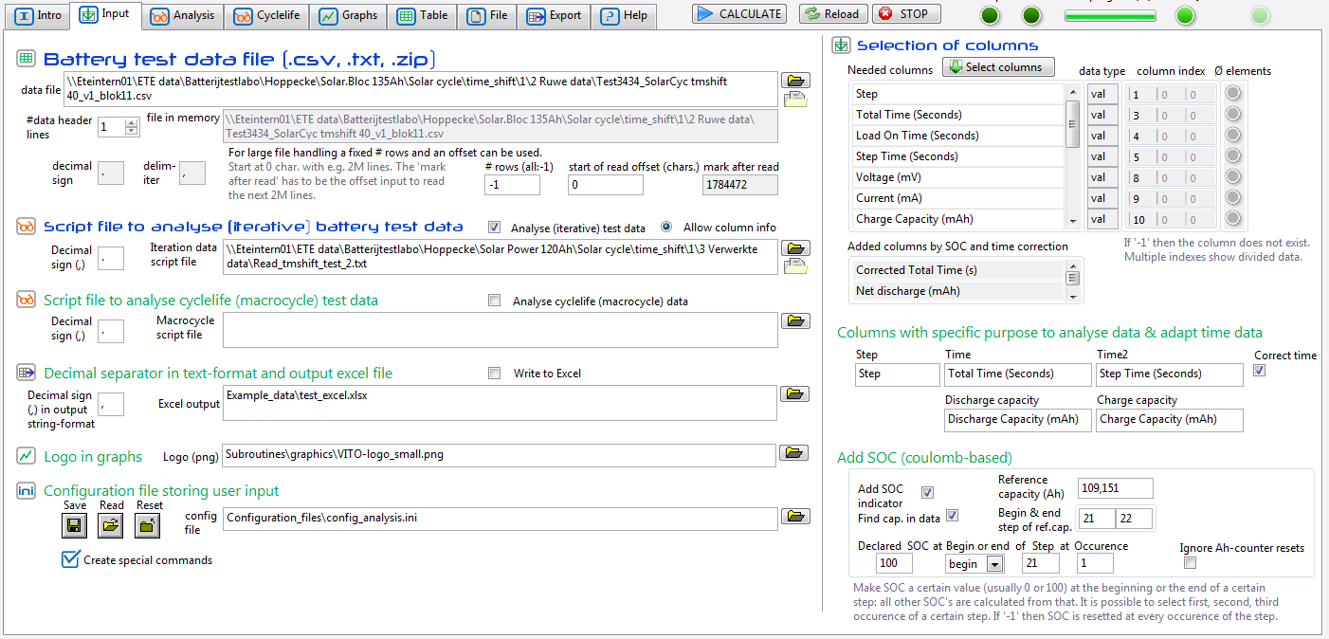
Introduction
Background
Grietus has a long history in data analysis and visualisation.
He created the BATAL suite.
This was created with LabVIEW.

Slide 4
Introduction
Background
.

Slide 5
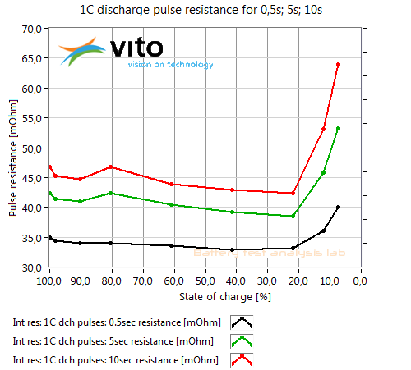
Introduction
Background
LabVIEW is powerful for creating graphical user interfaces.
However, python is stronger in data analysis

Slide 6
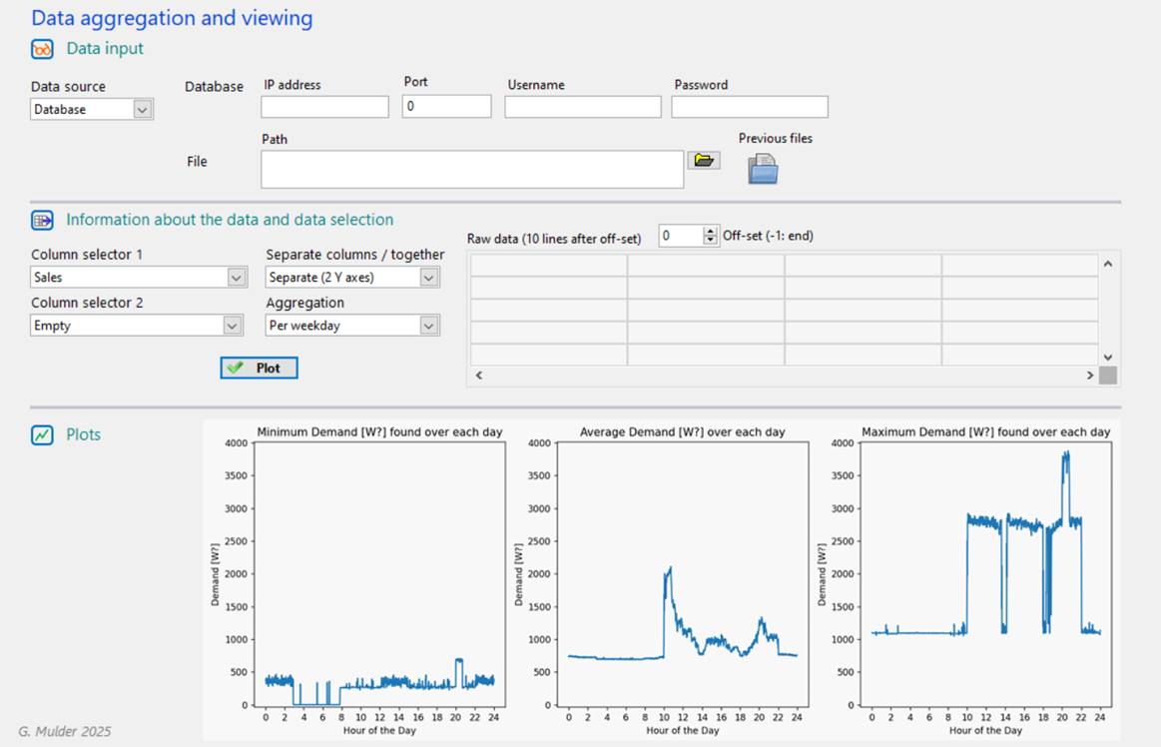
Introduction
Background
Aimed result like it could be in LabVIEW

Slide 7
Core approach
One file a starting point
One file that contains :
Datapaths
The needed options
The cleaning
The aggregation
The plotting
Data export
Selection by uncommenting and by adding new information
Only 100 lines pure code
Pandas is powerful

Slide 8
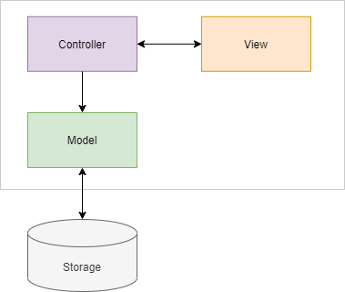
Core approach
GUI approach
GUI is based on Custom TKInter
This appears to be well developed with a lot of help on the internet
(in contrast with Kivy unfortunately)
Modular approach:
Three levels:
Model-View-Control
All functionality in separate modules
Distributed GUI modules
Callback function from submodule to main module
This keeps code short (200 lines)
Also helpful if several data sources are used
No parameters in middle of code

Slide 9
Core approach
GUI approach
GUI is based on Custom TKInter
This appears to be well developed with a lot of help on the internet
(in contrast with Kivy unfortunately)
Modular approach:
Three levels:
Model-View-Control
All functionality in separate modules
Distributed GUI modules
Callback function from submodule to main module
This keeps code short (200 lines)
Also helpful if several data sources are used
No parameters in middle of code

Slide 10
Core approach
Data cleaning
Depending if datetime is available
Remove empty columns
Merge lines with same timestamp
Fill empty data
Add weekday

Slide 11
Core approach
Data cleaning
Depending if datetime is available
Remove empty columns
Merge lines with same timestamp
Fill empty data
Add weekday
Example

Slide 12
Core approach
Data aggregation
Identify the weekdays
Identify the same hours, minutes
Aggregate by groupby
and indexes
Determine minimum, average and maximum

Slide 13

Core approach
CSV reading
This appears weak in Python
No good functionality to discover data structure
Needed:
Start of data
Column names in 1 or divided over 2 lines
Delimiter
Decimal sign
CleverCSV appears a bit better than CSV
Correct delimiter recognition

Slide 14
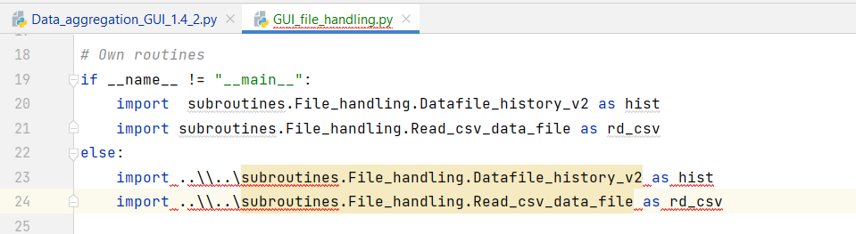
To be done
Solve path dependency in submodules
Submodules cannot straightforwardly be tested:
Paths start from main module
(going backwards is not possible)

Slide 15
To be done
Package creation
Configuration files for parameters
__init__.py application
Path encapsulation
Error capture with output to user
Errors are now ‘invisible’: stay in compiler
Unit tests
Executable
Documentation

Slide 16
Result
GUI creation
GUI: original code x 20 …

Slide 17


Take aways/ experiences
www.syntrapxl.be
Plus
Pandas for python is powerful in data aggregation
Copilot can assist well
Certainly to find small errors
Learning by doing
‘__name__ = “ __main__’ : helpful for testing and adapting modules
(if path dependency is solved)
GUI distribution approach can be shared if wanted

Slide 18

Take aways/ experiences
www.syntrapxl.be
Minus
Dictionaries with parameters difficult to manage between modules
No single point of definition
CSV reading not well established
Architectures seem not common
Coding a GUI is a real effort
Code exploses
GUI module distribution with callback towards main module is necessary
No ‘return’ possible at end of function
Applying the index in pandas is combination with graphs is not easy
The column name is lost temporarily

